Slide 1
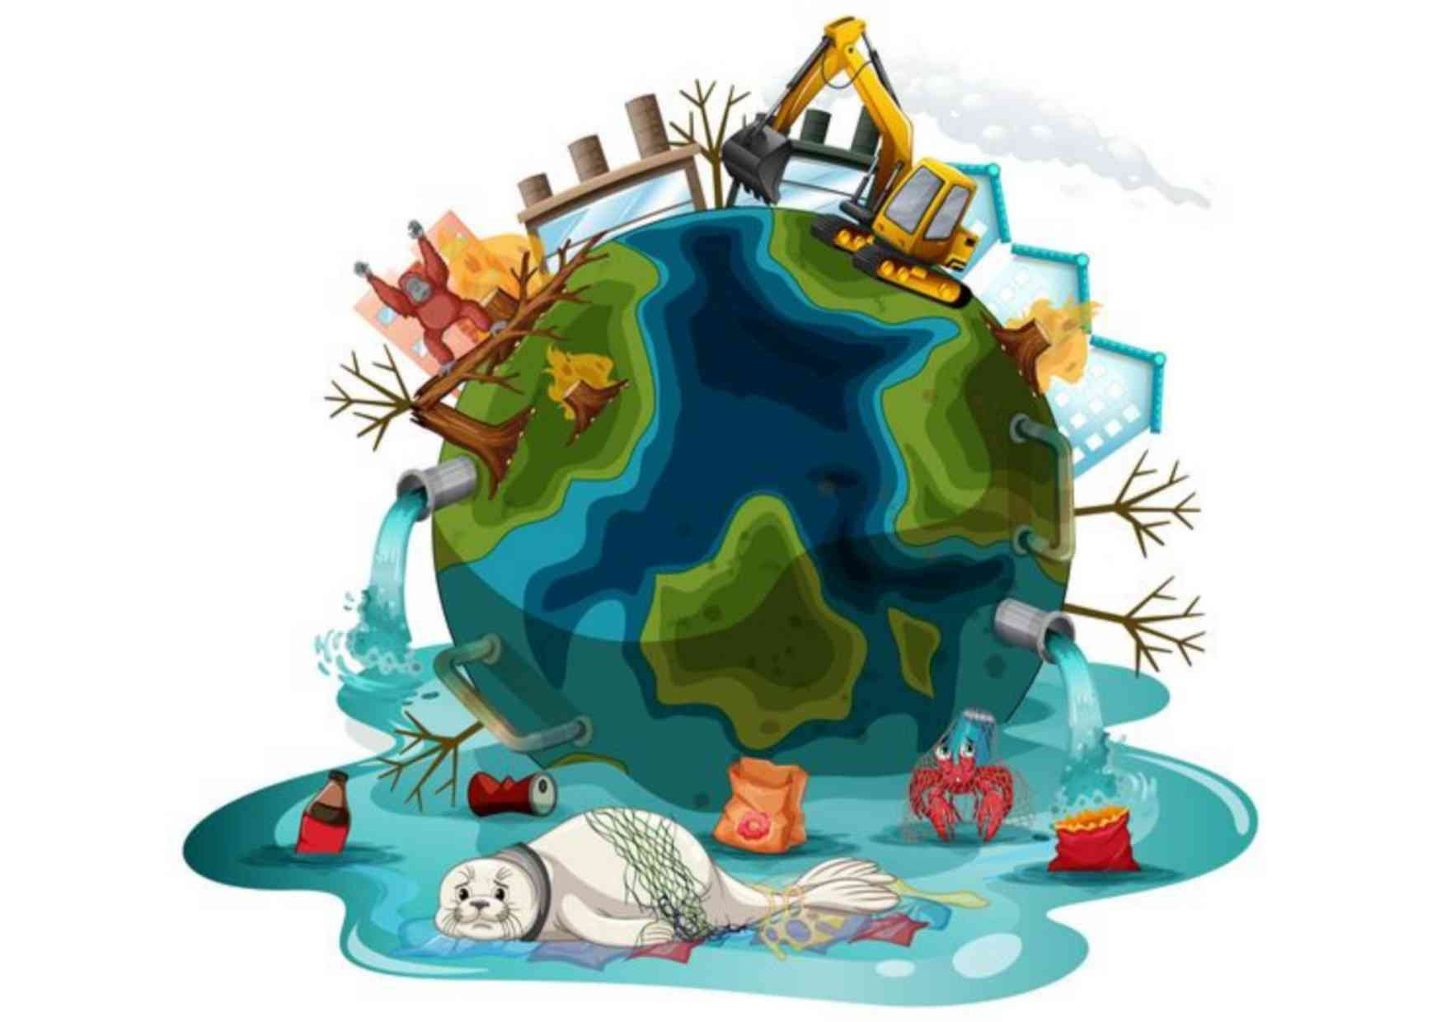
Environmentally
Speaking
Why Is Litter Bad?
Unit 3, Week 2

Slide 2
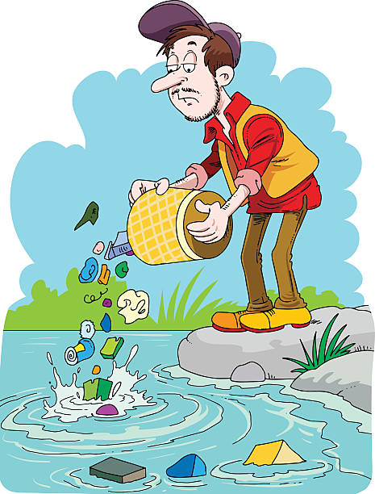
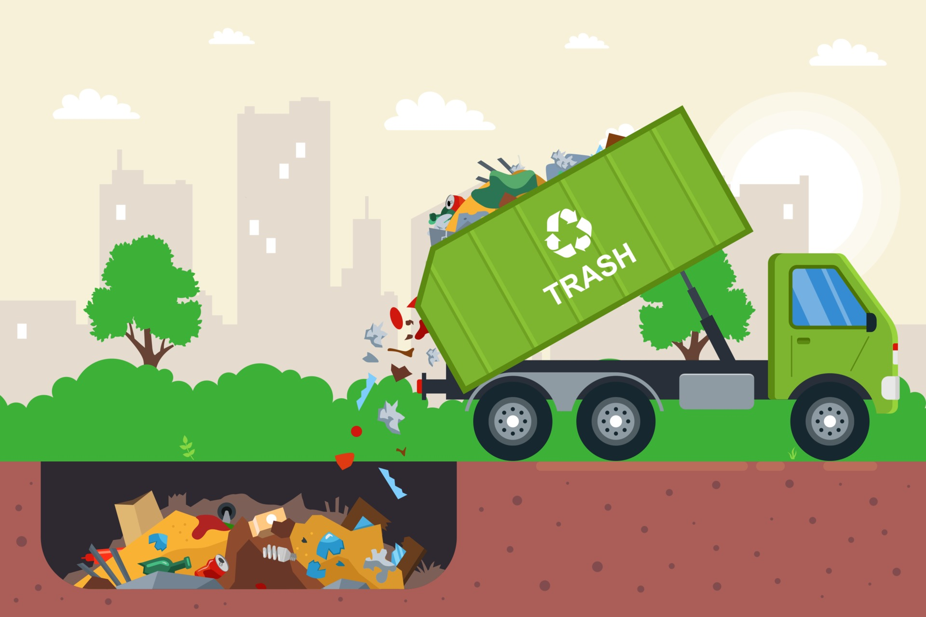
Simple Present Tense: Verb forms
Pollute
Affect
Burn
Bury

Slide 3
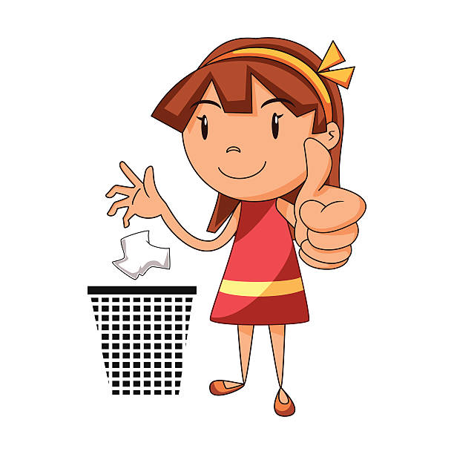
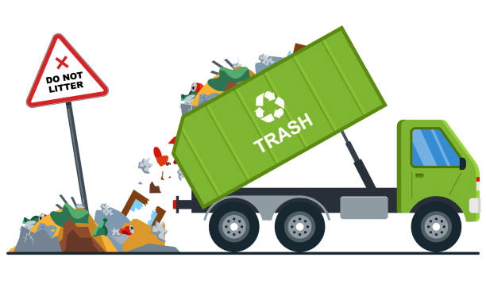
Simple Present Tense: Verb forms
Dump
Trap
Look
Throw

Slide 4
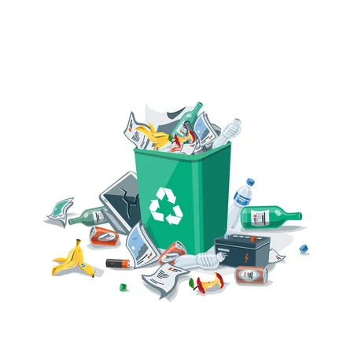
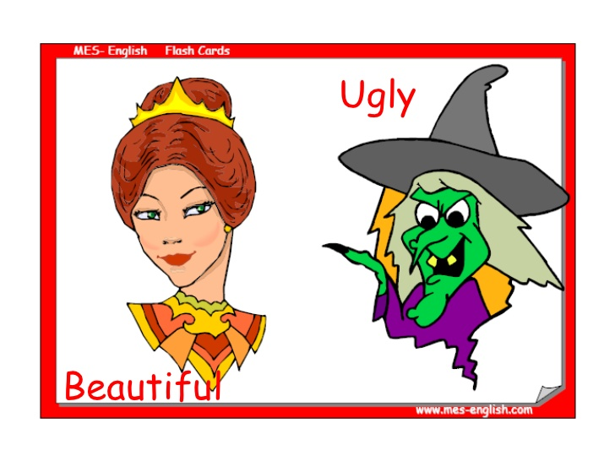
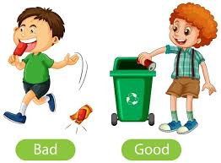
Adjectives
Littered
Ugly

Slide 5
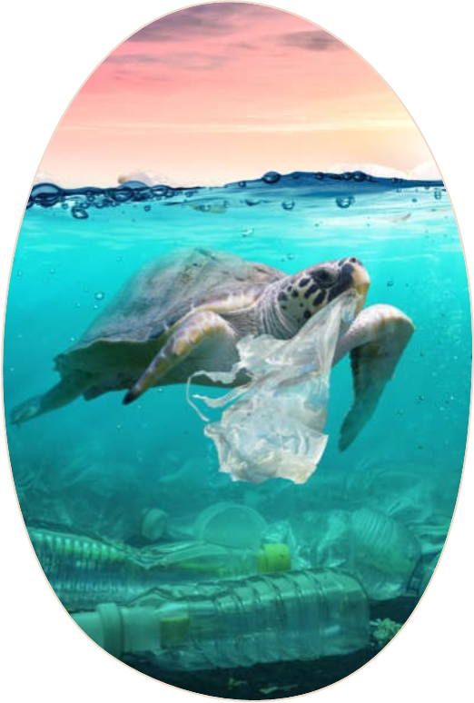
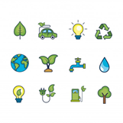
Why is Litter Bad?
Because it affects the environment.
Because it affects
water.
Because it affects
health.
Because it affects ecology.
Because it affects all living things on Earth.
Because it affects
recreation.

Slide 6
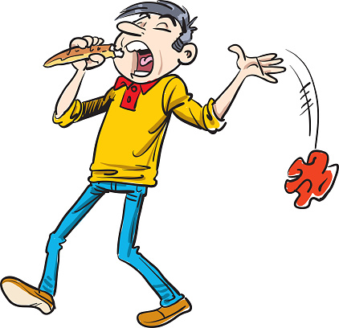
Who leaves litter on the ground?
People leave litter on the ground.

Slide 7
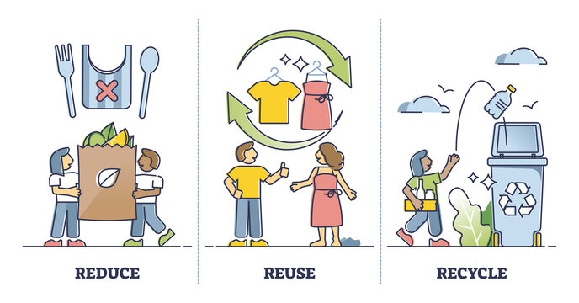
What can you do about litter?
I can reduce, reuse and recycle.

Slide 8
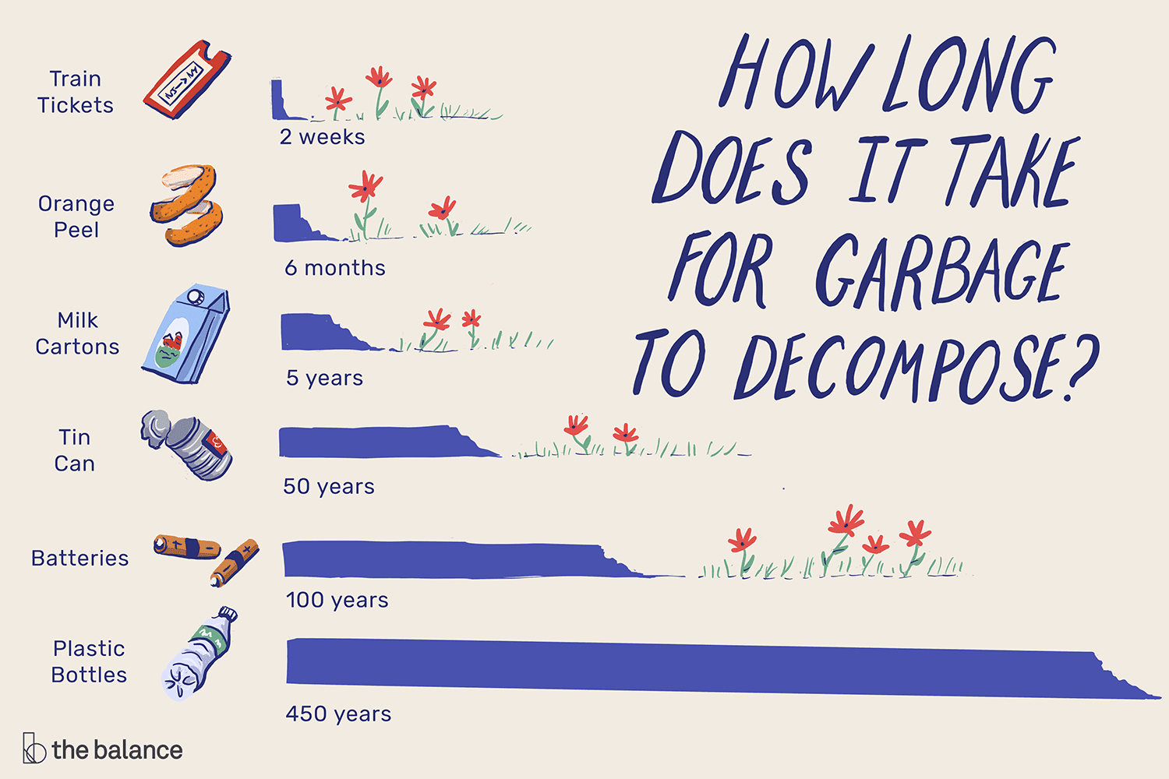
Which kind of litter take longer to decompose?

Slide 9
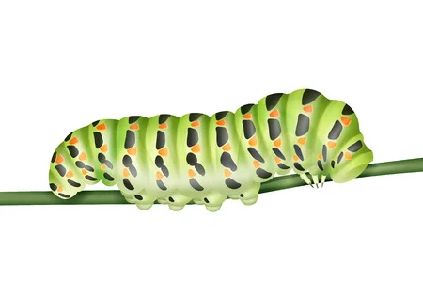
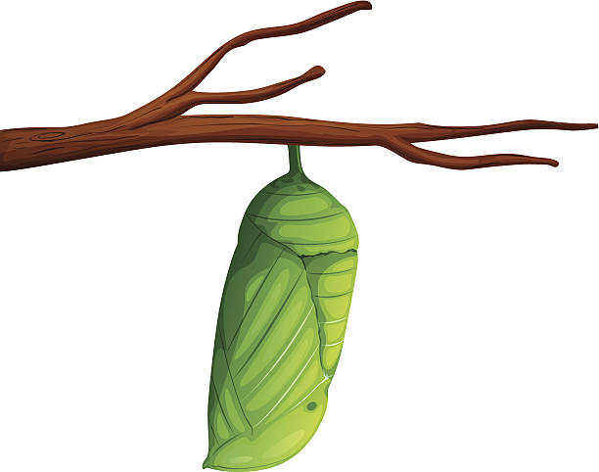
Sequence Adverbs
2
3
4
First
Then
After that
Finally

Slide 10
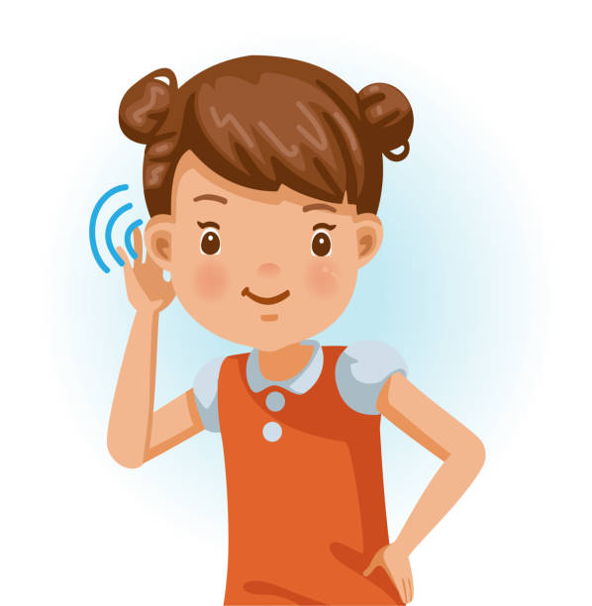
Idioms
Listening attentively.
Don’t care at all about something.
I’m all ears
Give a hoot, don´t pullute!

Slide 11
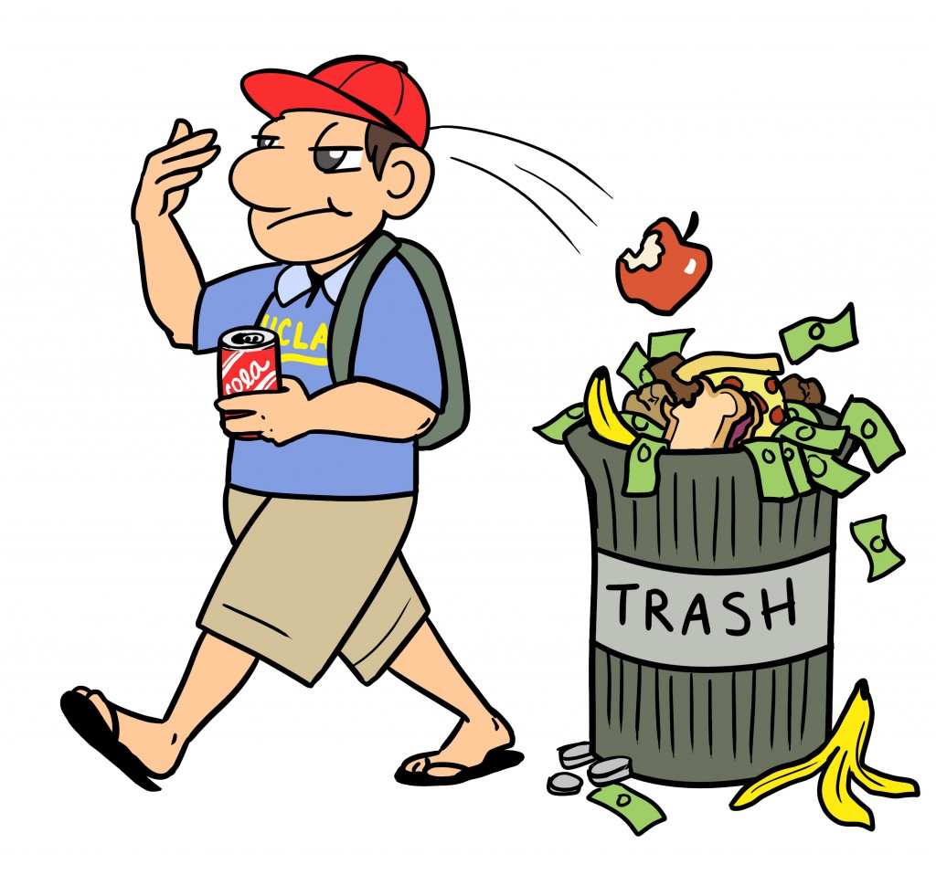
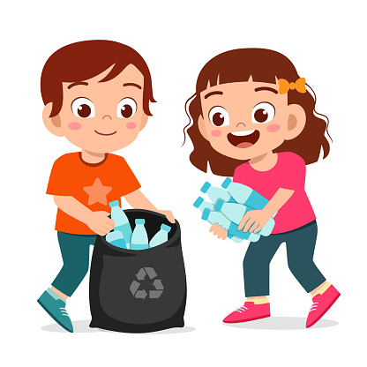
Idioms
Carelessly drop litter in a public
place.
Become environmentally conscious in your decisions.
Litter bug
Go Green

